Slide 1

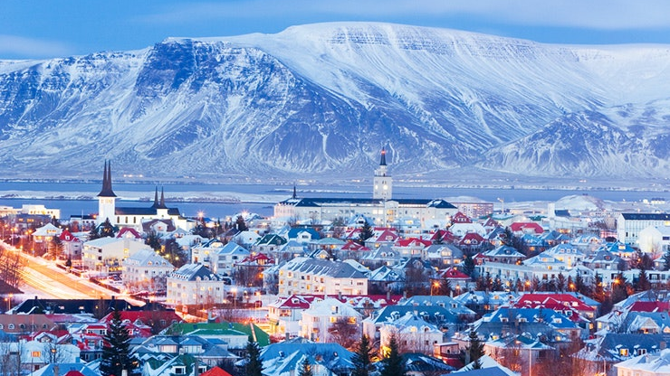
Iceland's Energy Revolution: A Journey to a Sustainable Future
ICELAND
Presented by: Mansi Deepak Kondekar
Of ITTM-11
Under the Guidance of: Anuj Prasanth Manikoth

Slide 2
ICELAND
Iceland is a Nordic island country in the North Atlantic Ocean and in the Arctic Ocean. Iceland is the most sparsely populated country in Europe.
Today, almost 100 percent of the electricity consumed in this small country of 330,000 people comes from renewable energy.
Additionally, 9 out of every 10 houses are heated directly with geothermal energy.
Notes:
In an era when climate change is making it necessary
for countries around the world to implement sustainable energy solutions, Iceland presents a unique situation.
Iceland therefore provides lessons for its neighbors in Europe currently dealing with an energy crisis accelerated by Russia’s invasion of Ukraine.

Slide 3
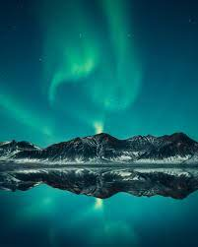
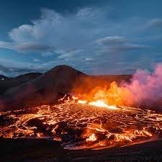
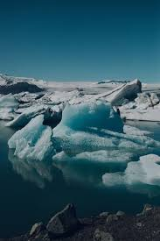
ICELAND
Iceland is a Nordic island country between Greenland and Norway. Iceland is the most sparsely populated country in Europe.
Today, almost 100 per cent of the electricity consumed in this small country of 330,000 people comes from renewable energy.
Additionally, 9 out of every 10 houses are heated directly with geothermal energy.

Slide 4
LAND OF FIRE AND ICE AND THE NORTHEN LIGHTS
Notes:
Iceland is often called "the land of fire and ice". It is this mixture of geology and northerly location that gives the country its extensive access to renewables. The island lies on very active volcanic zone that powers its geothermal systems. Glaciers cover 11 per cent of the country. Seasonal melt feeds glacial rivers, which run from mountains to the sea contributing to Iceland's hydropower resources.
Furthermore, the country has tremendous wind power potential, which remains virtually untapped.

Slide 5
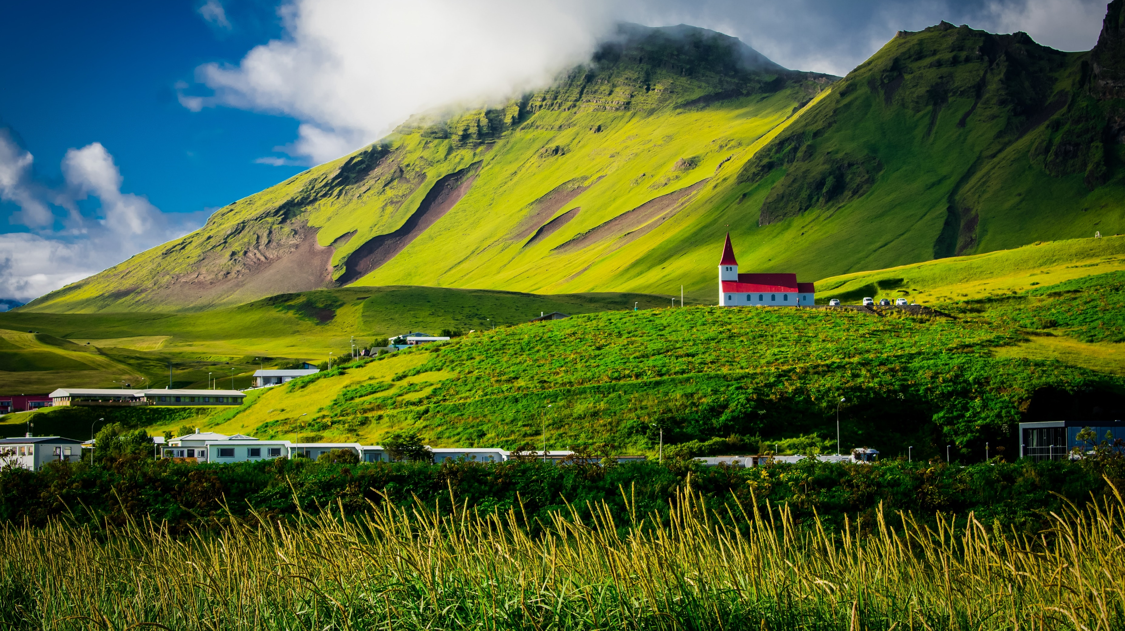
History
The main drivers of this transition were the difficulties associated with keeping up with fluctuating oil prices, which were only made worse by the 1973 oil crisis that sent prices skyrocketing.
Notes:
While today Iceland is a strong example of how renewable energy can power a modern economy, this has not always been the case. it was not the importance of renewables for climate change that led to this development. The drive behind this transition was simple-Iceland could not sustain oil price fluctuations occurring due to a number of crises affecting world energy markets. It required a stable and economically feasible domestic energy resource

Slide 6
History
The main drivers of this transition were the difficulties associated with keeping up with fluctuating oil prices, which were only made worse by the 1973 oil crisis that sent prices skyrocketing.
First steps towards Iceland’s renewable developments, both for geothermal and hydropower, were taken by local entrepreneurs. Municipalities gradually built on this success leading systematic explorations.
Notes:
The challenging first steps towards Iceland's renewable developments, both for geothermal and hydropower, were taken by local entrepreneurs. In the early twentieth century, a farmer found a way to use the hot water seeping out of the ground to develop a primitive geothermal heating system for his farm. Municipalities gradually built on his success leading to more systematic exploration of the geothermal resources. Larger projects were then developed with the implementation of geothermal district heating systems on a commercial scale.

Slide 7
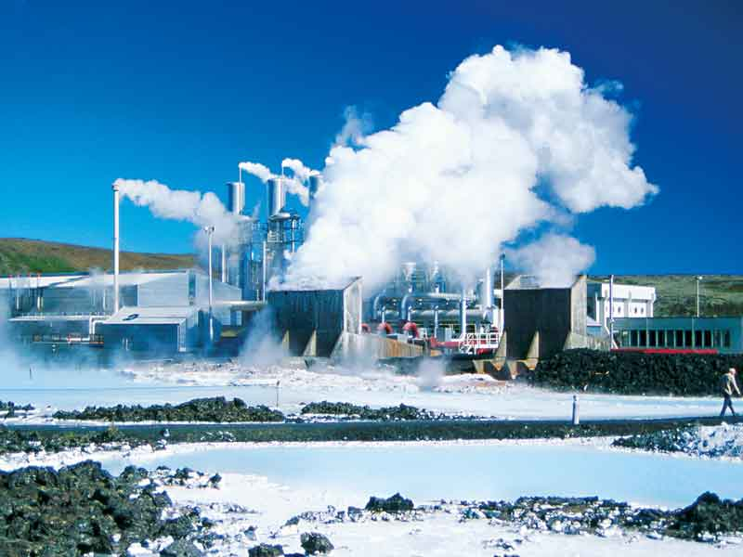
History
Geothermal energy is one of Iceland's primary renewable energy sources. The country has a high concentration of geothermal activity due to its location on the Mid-Atlantic Ridge, where two tectonic plates meet.
The challenging first steps towards Iceland’s renewable developments, both for geothermal and hydropower, were taken by local entrepreneurs.
Iceland has harnessed this geothermal energy through the use of geothermal power plants, which generate electricity and provide heating for homes and businesses.
The main drivers of this transition were the difficulties associated with keeping up with fluctuating oil prices, which were only made worse by the 1973 oil crisis that sent prices skyrocketing.
First steps towards Iceland’s renewable developments, both for geothermal and hydropower, were taken by local entrepreneurs. Municipalities gradually built on this success leading systematic explorations.
Iceland is a country that has made significant progress in its energy transition journey. The country has been able to shift from using fossil fuels to renewable energy sources, primarily solar, wind, geothermal and hydroelectric power.

Slide 8
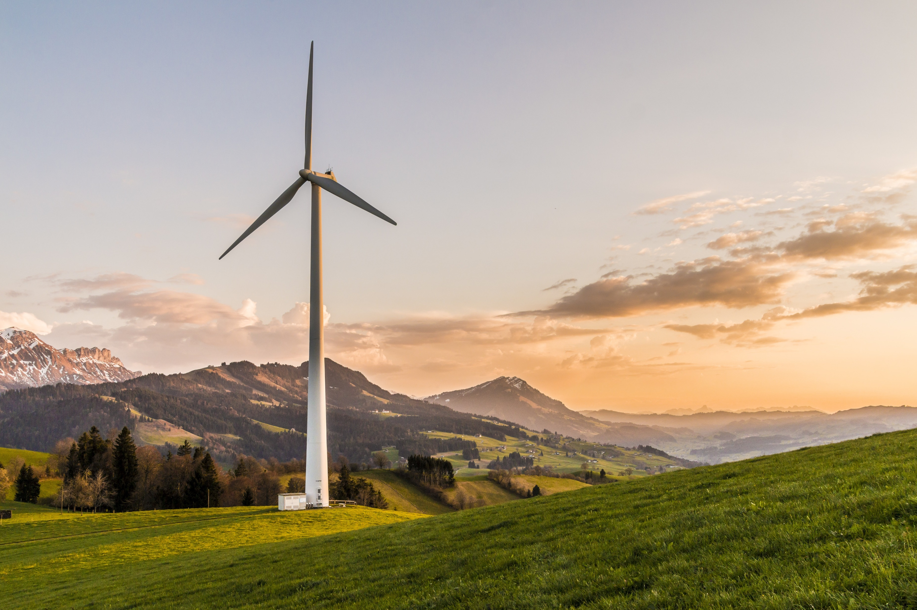

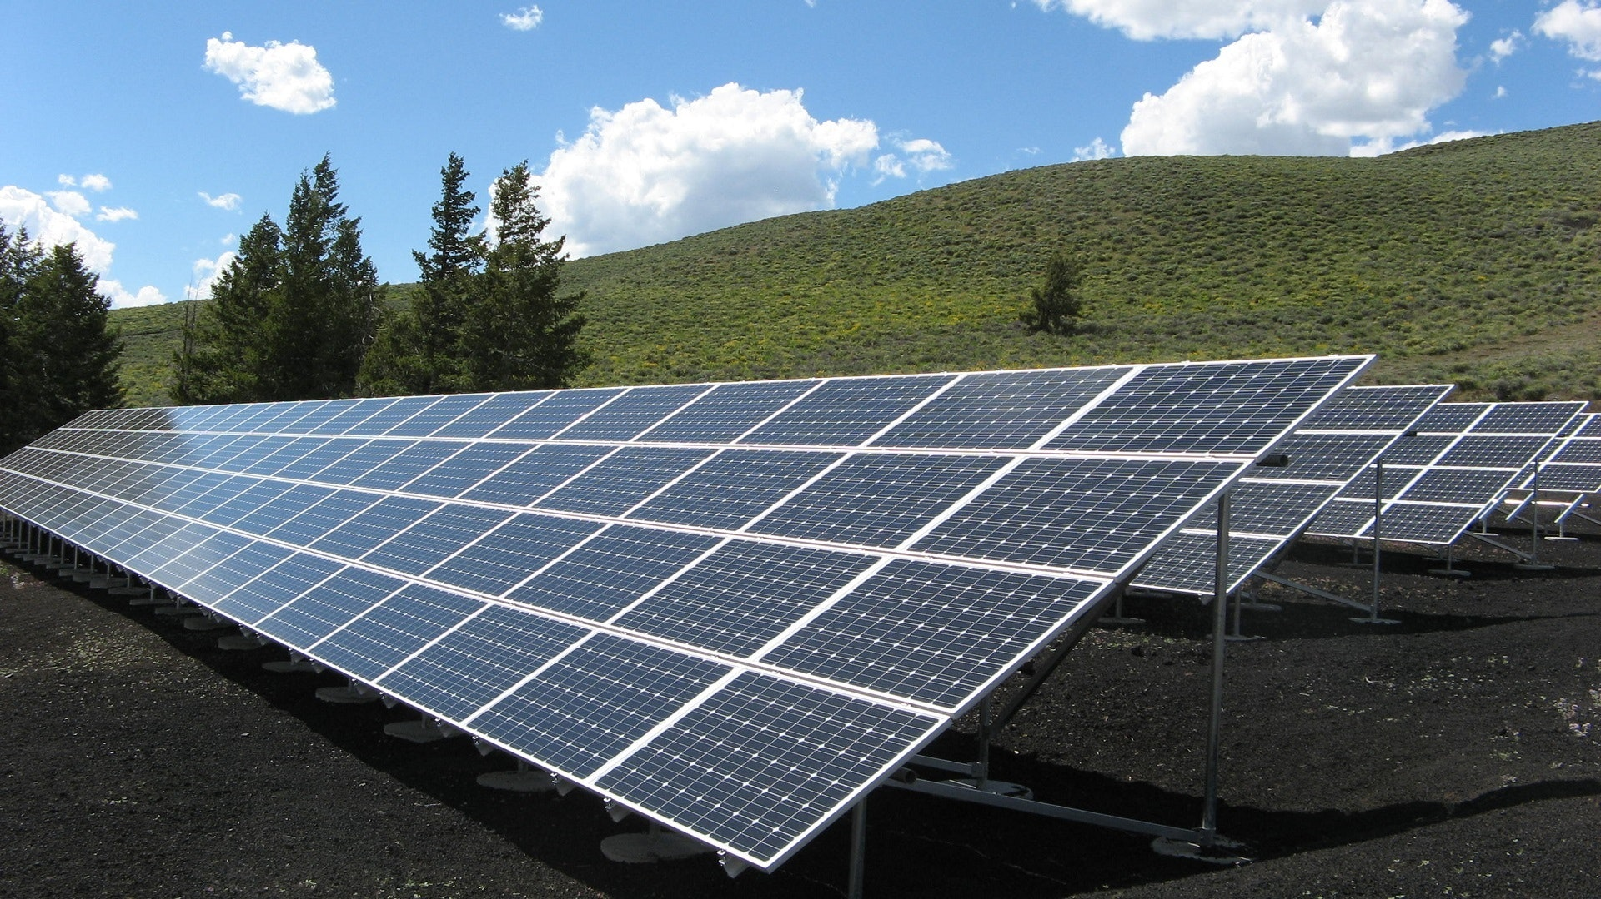
Solar and Wind Energy
The energy transition is currently dominated by wind and solar which accounted for 32% and 51% of renewable net capacity in 2021.
Notes:
Both are intermittent sources since they generate electricity from technologies whose power output is weather dependent. Storage and battery capacity is improving which will mitigate this concern.

Slide 9
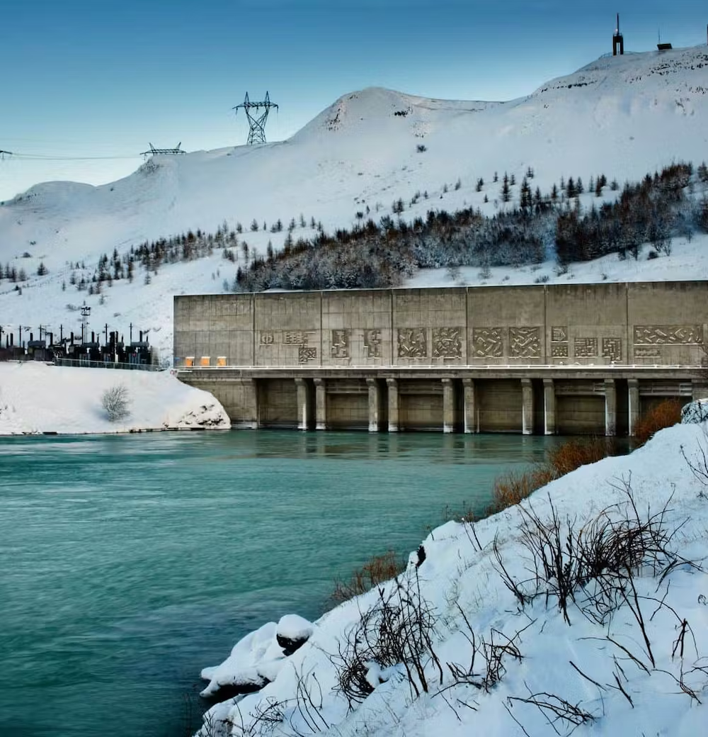
Geothermal Energy
Geothermal energy is one of Iceland's primary renewable energy sources. The country has a high concentration of geothermal activity due to its location on the Mid-Atlantic Ridge, where two tectonic plates meet.
Iceland has harnessed this geothermal energy through the use of geothermal power plants, which generate electricity and provide heating for homes and businesses.
Source: The New Economy
Notes:
The famous Blue Lagoon is entirely powered by geothermal energy
Iceland has over 600 hot springs and 200 volcanoes The hot water is so cheap in Iceland that Icelanders are known for their long showers

Slide 10

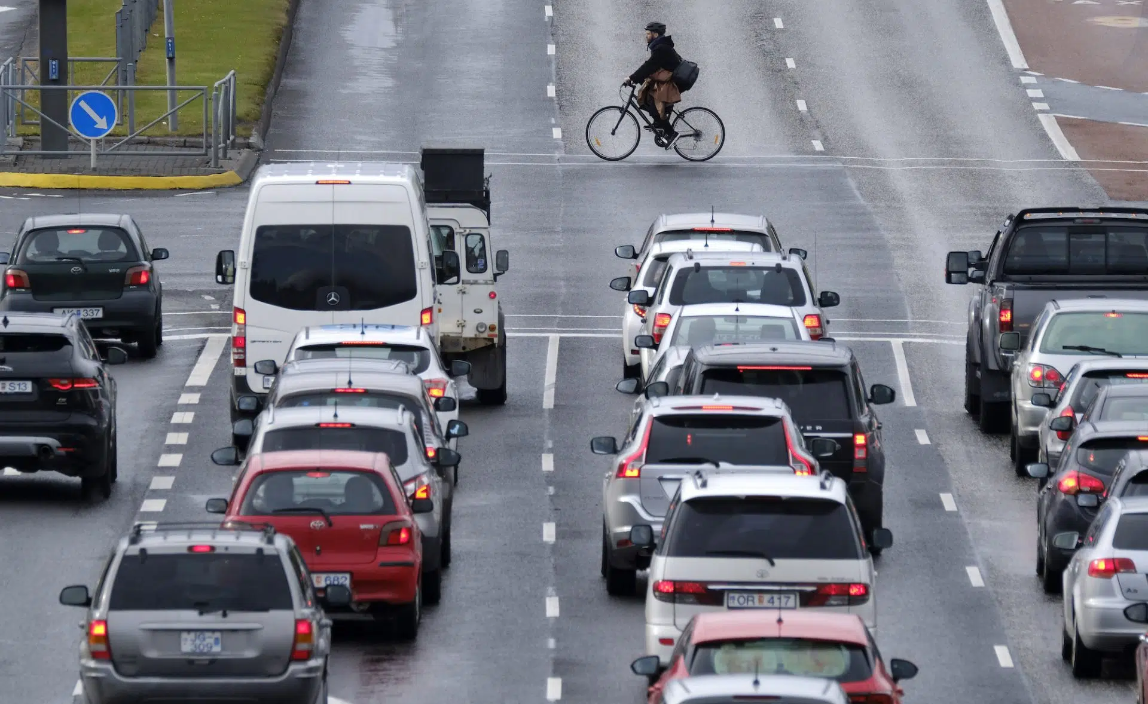
Hydroelectric Power
Hydroelectric power is another significant source of renewable energy in Iceland. The country has numerous rivers and waterfalls, which are ideal for generating electricity.
Iceland has built several hydroelectric power plants, which provide electricity to the national grid and help reduce the country's reliance on fossil fuels.
Over 70% of Iceland’s electricity comes from hydropower.
Source: Landsvirkjun
Notes:
Iceland's nature is rich in cascading waterfalls and strong glacial rivers. Over the years, Icelanders learned how to use it, not only for their recreation purposes but also to generate electricity.

Slide 11
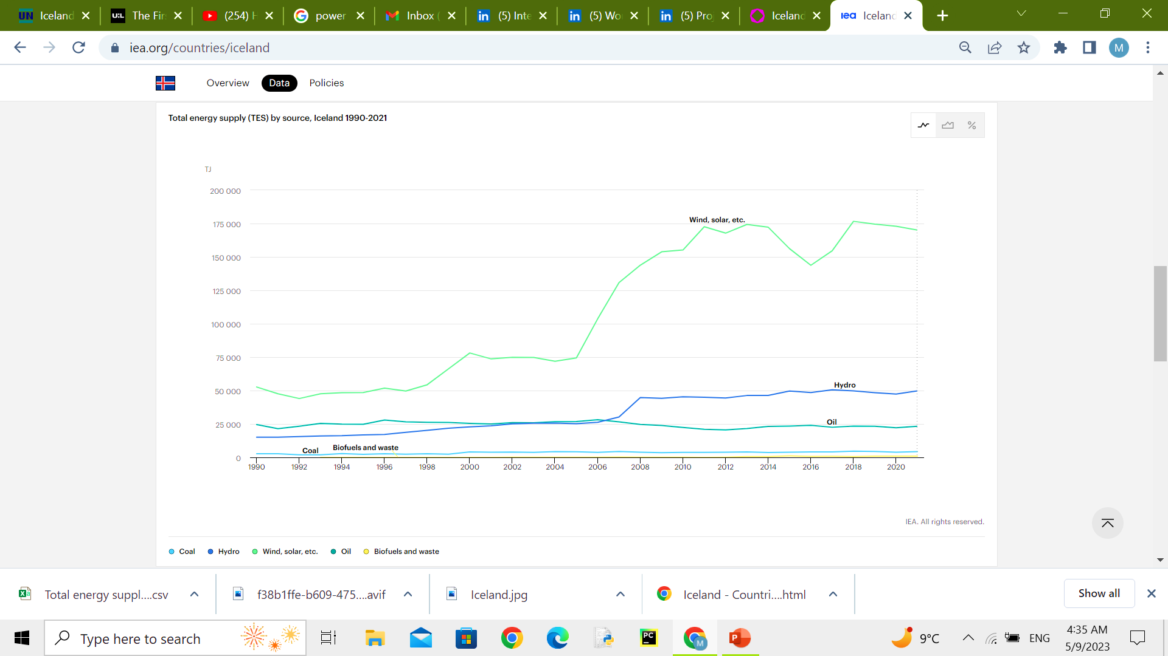
Transportation
Iceland has also made strides in transitioning its transportation sector to renewable energy. The country has a high rate of electric vehicle adoption, and the government has implemented policies to incentivize the use of electric cars.
Additionally, Iceland has invested in infrastructure for hydrogen fuel cell vehicles, which have the potential to be an even cleaner alternative to electric cars.
The objective is to increase the share of renewable energy in on-land transport from 10% in 2020 to 40% 2030.
Source: Iceland Review

Slide 12
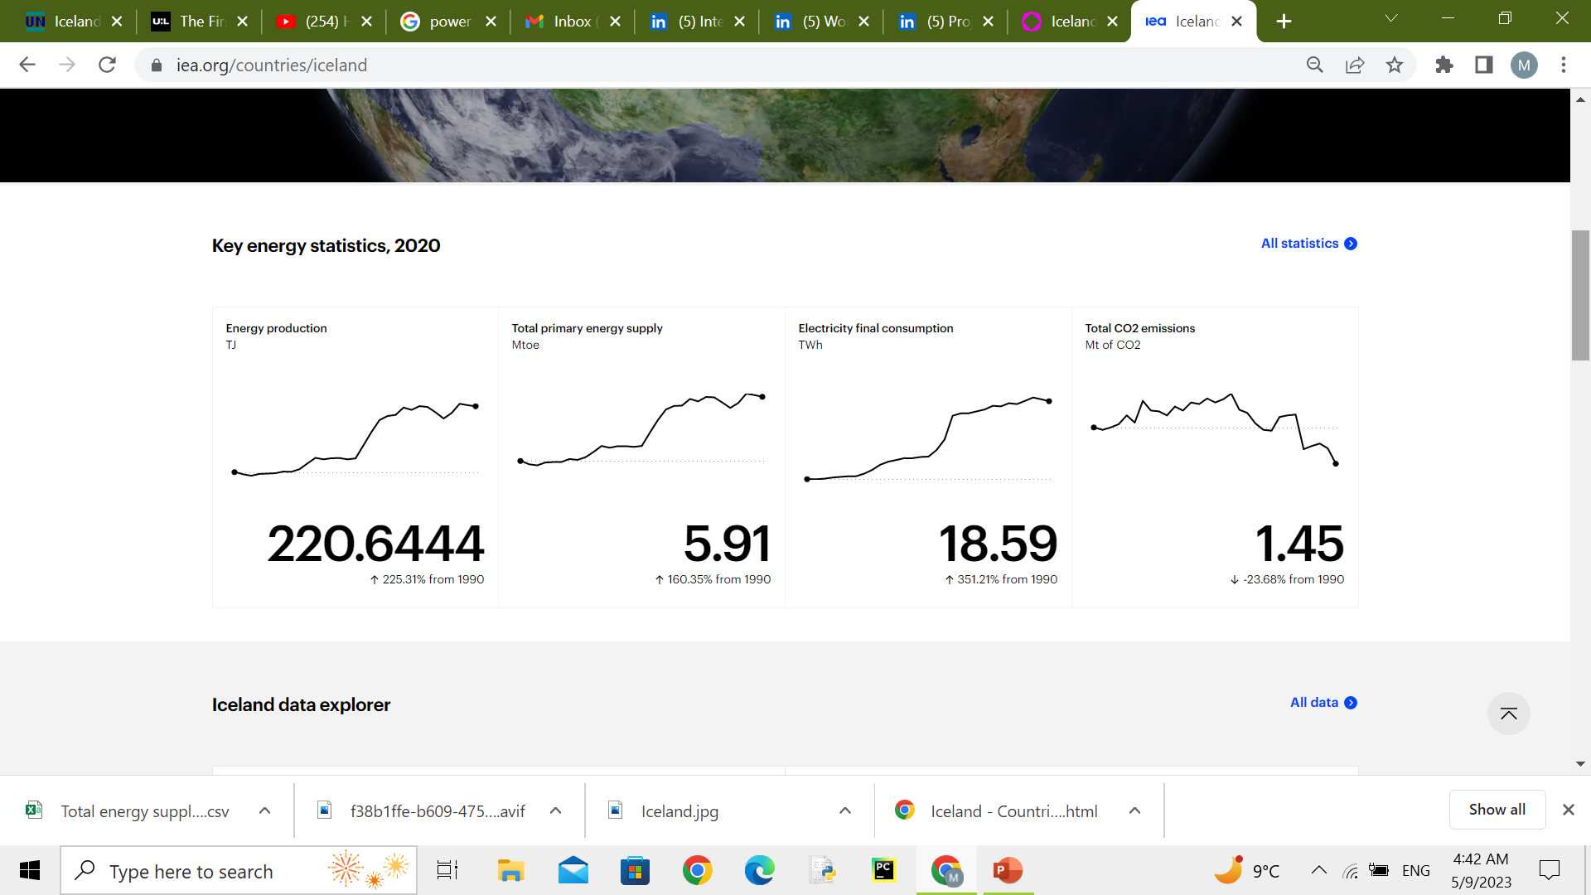
Source: https://www.iea.org/countries/iceland
Notes:
Biomass: this is only 5% farmable land only 1% is being used so not enough production.

Slide 13
Source: https://www.iea.org/countries/iceland

Slide 14
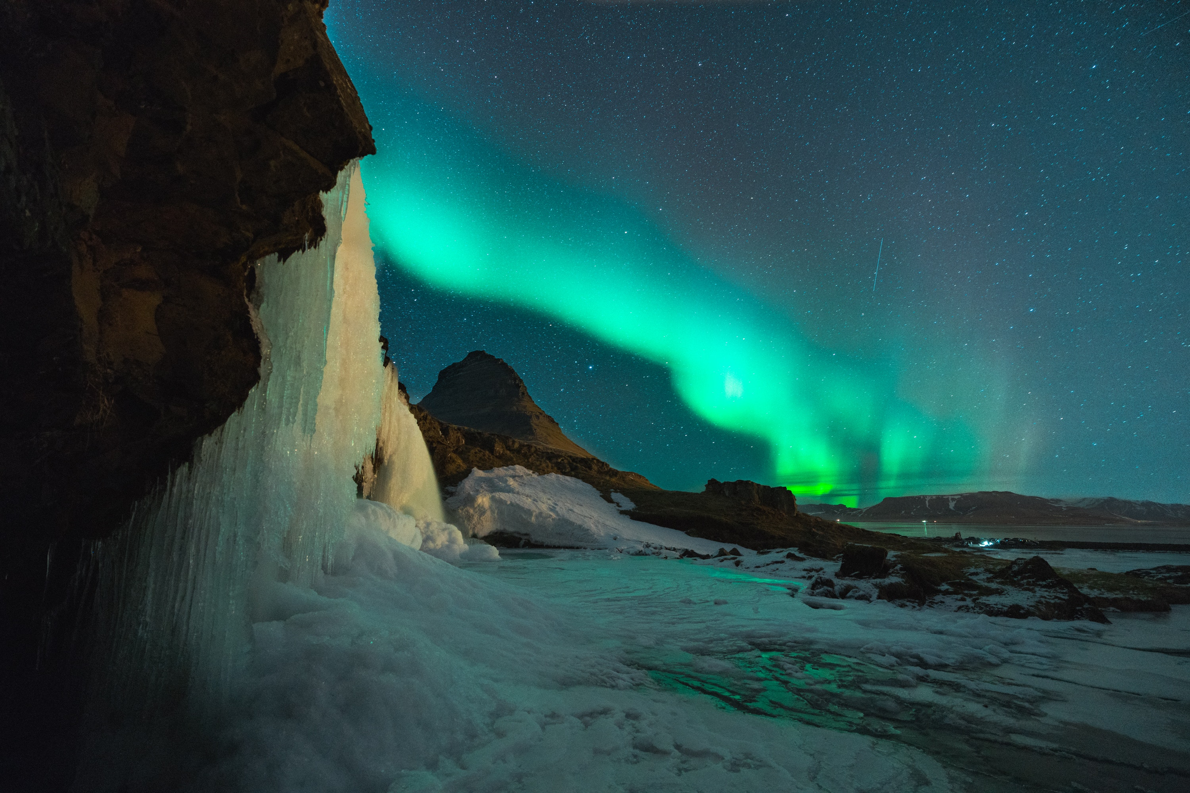
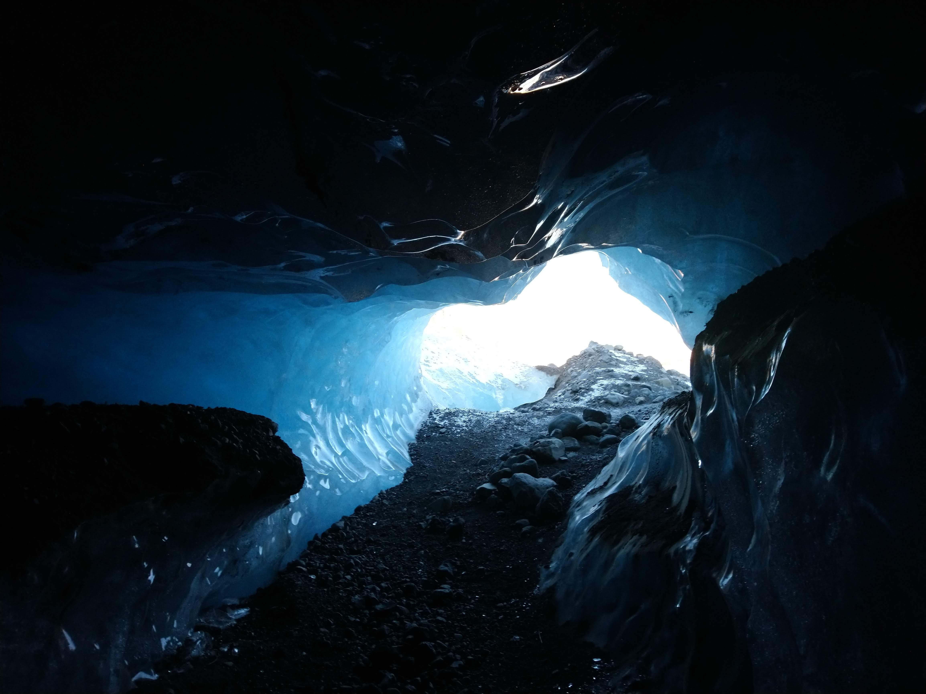
Advantages:
Self sufficiency
Reduction in foreign currency expenses
Reduce Carbon footprint
Improving Air quality
Creating Job opportunity
Adding to the GDP of the country.
Notes:
Parliamentary resolution on energy transition The resolution proposes an action plan to increase the share of domestic renewable energy sources at the expense of imported fossil fuels. The energy transition will result in increased energy efficiency and energy security, as well as a reduction in foreign currency expenses and greenhouse gas emissions.

Slide 15
Challenges
Despite its successes, Iceland still faces challenges in its energy transition journey. One of the main challenges is the country's heavy reliance on the fishing industry, which is a significant contributor to greenhouse gas emissions.
Another challenge is the need to balance economic growth with sustainability. As Iceland continues to grow, it must ensure that its energy transition efforts do not come at the cost of environmental degradation.
Notes:
Energy storage and battery capacity need to improve.

Slide 16
Conclusion
In conclusion, Iceland has made remarkable progress in its energy transition journey. The country has shown that it is possible to shift from fossil fuels to renewable energy sources, even in challenging environments.
However, there is still much work to be done, and Iceland must continue to innovate and invest in sustainable solutions to ensure a brighter future for generations to come.
Notes:
The good news is that the world has never before been more prepared to undertake the forthcoming change. New and improving technologies are becoming available all the time, as are better funding schemes. Cooperation and sharing of know-how around the globe are becoming increasingly easy and instantaneous. Combining these factors with the many lessons learned in the past, such as from Iceland, will prove to be a powerful tool for countries in achieving a more sustainable path.

Slide 17
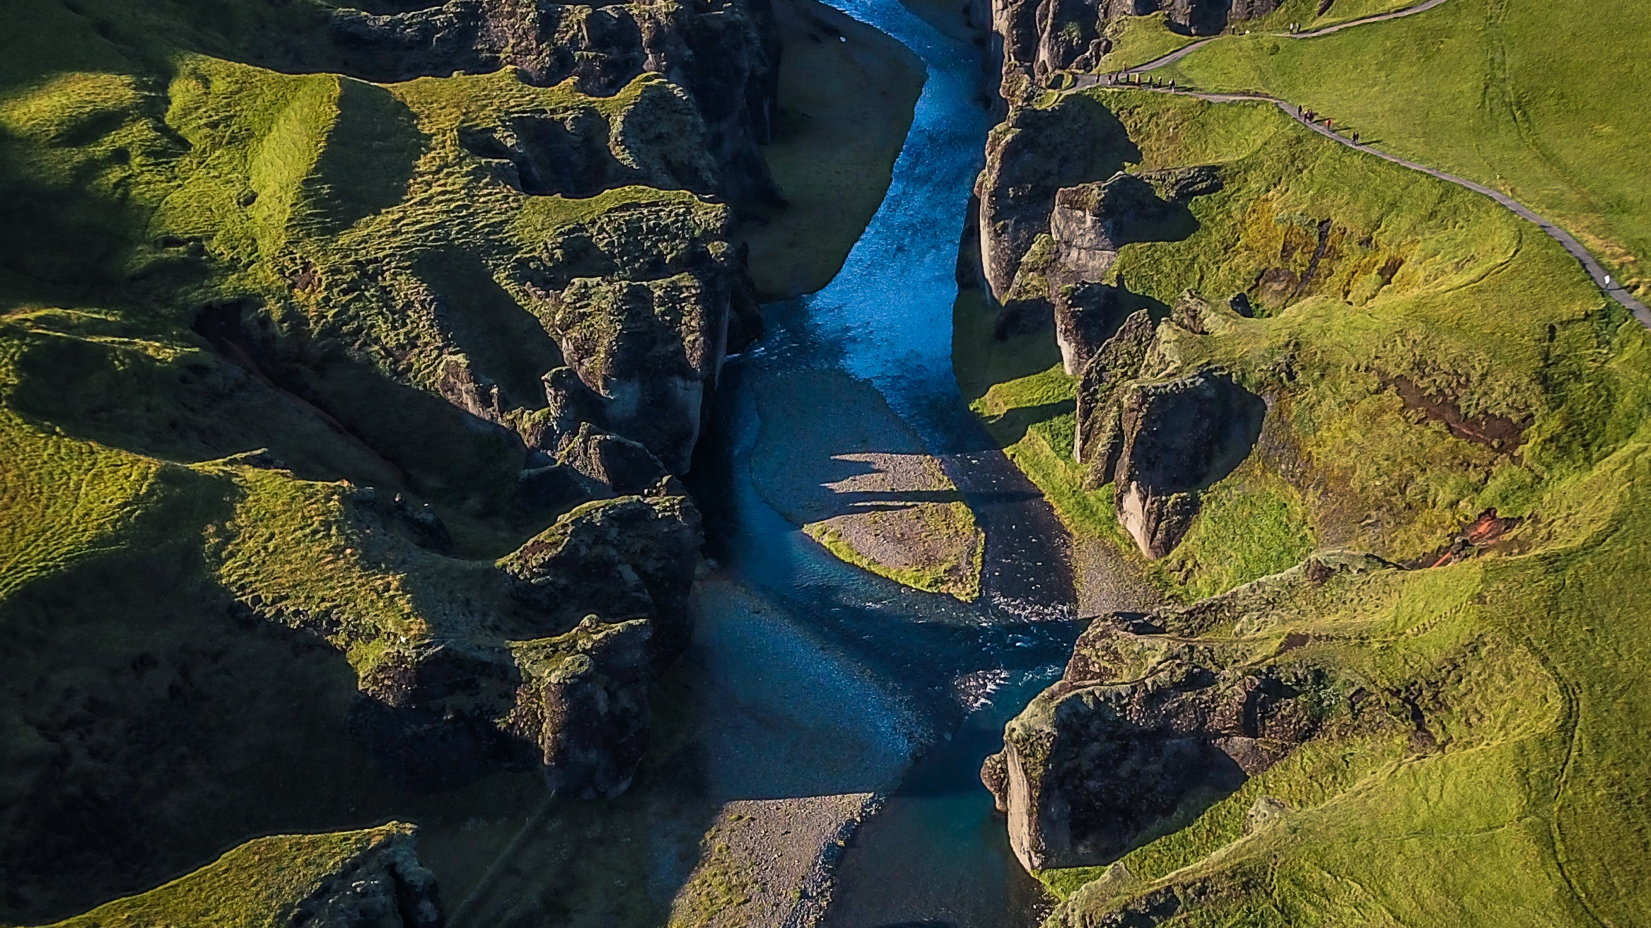
Reference:
https://www.un.org/en/chronicle/article/icelands-sustainable-energy-story-model-world
https://www.theurbanlist.com/a-list/the-first-timers-guide-to-iceland-amex-explorercard17
https://www.iea.org/countries/iceland
https://impact.economist.com/sustainability/ecosystems-resources/circular-and-renewable-lessons-from-the-island-of-iceland
https://www.wartsila.com/insights/article/a-sustainable-energy-revolution-the-icelandic-way

